Slide 1
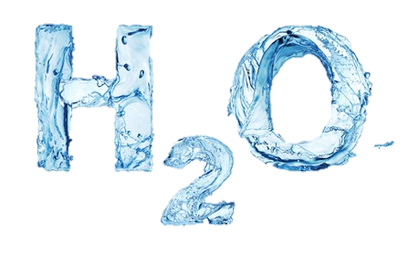
Consumption Study
SJ Zimmermann

Slide 2
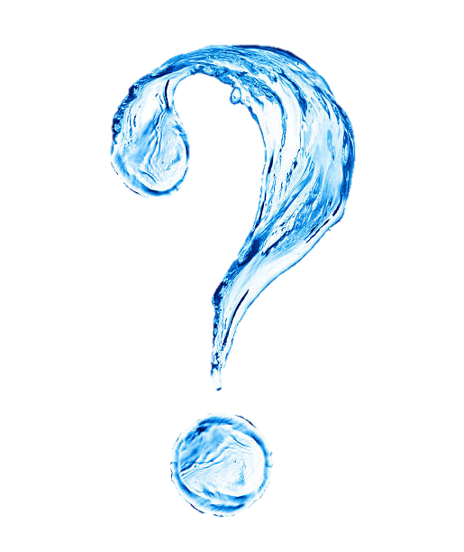
Question
Does my average daily consumption of water meet the recommended 64 ounces?
What is the average difference?

Slide 3
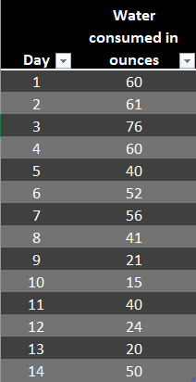
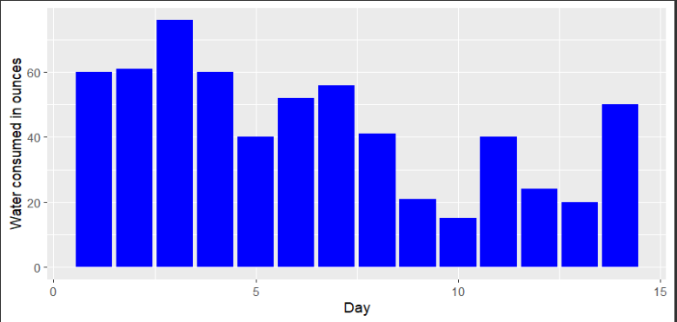

Data
Water consumption was measured by drinking only out of a measured water bottle and recording daily consumption in Excel over a 14 day period
Variables- Days and amount of water consumed in ounces.

Slide 4
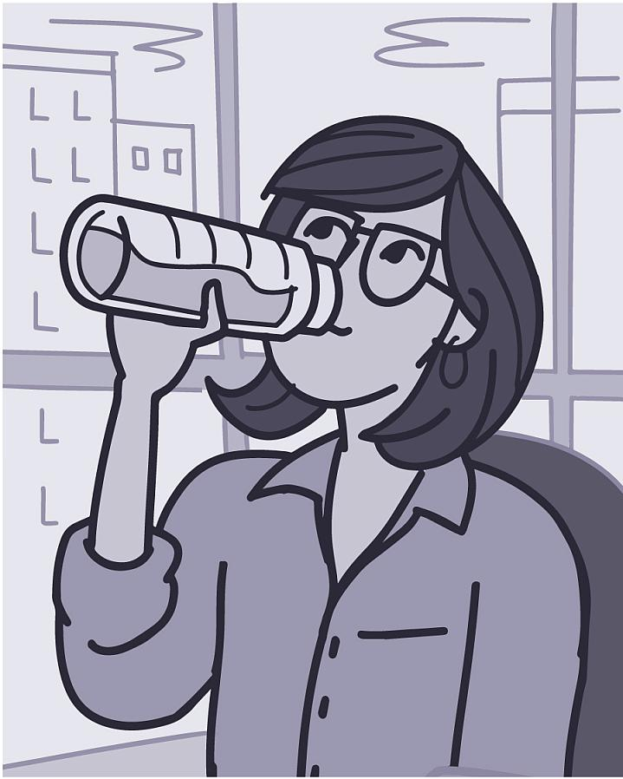

Hypothesis Testing
Claim- The mean amount of water consumed on a daily basis is less than 64 ounces.
$H_{0 }$: $μ$=64 ounces
$H_{a }$: $μ$<64 ounces

Slide 5
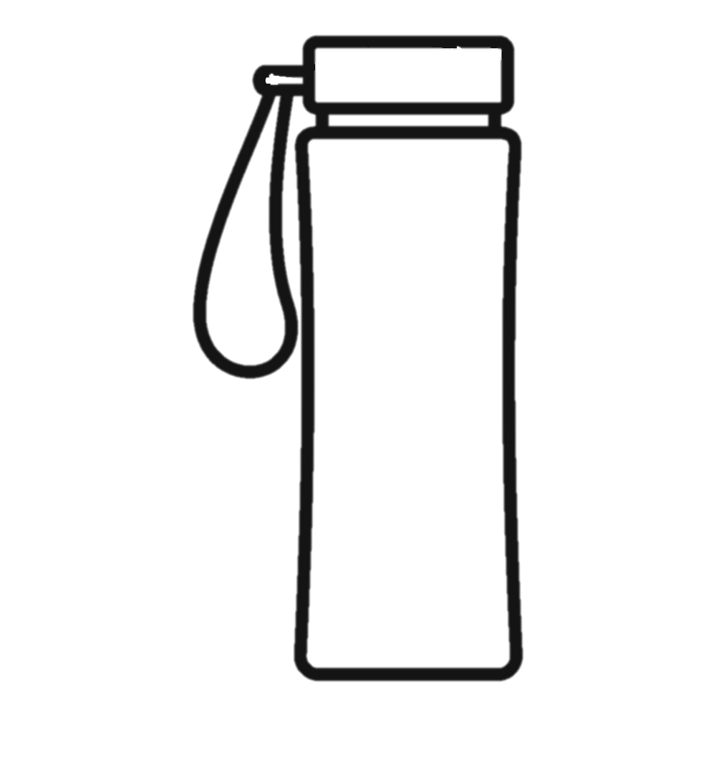
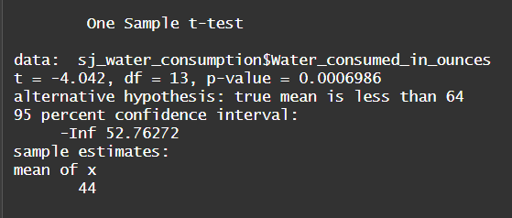
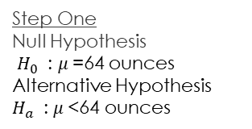
Hypothesis Testing
Step Four
Using a significance level .05, we reject the null hypothesis
Step Three
Test Statistic:
T=-4.042
P-value= 0.0006986
Step Two
Use t-test
Step One
Null Hypothesis
$H_{0 }$: $μ$=64 ounces
Alternative Hypothesis
$H_{a }$: $μ$<64 ounces

Slide 6
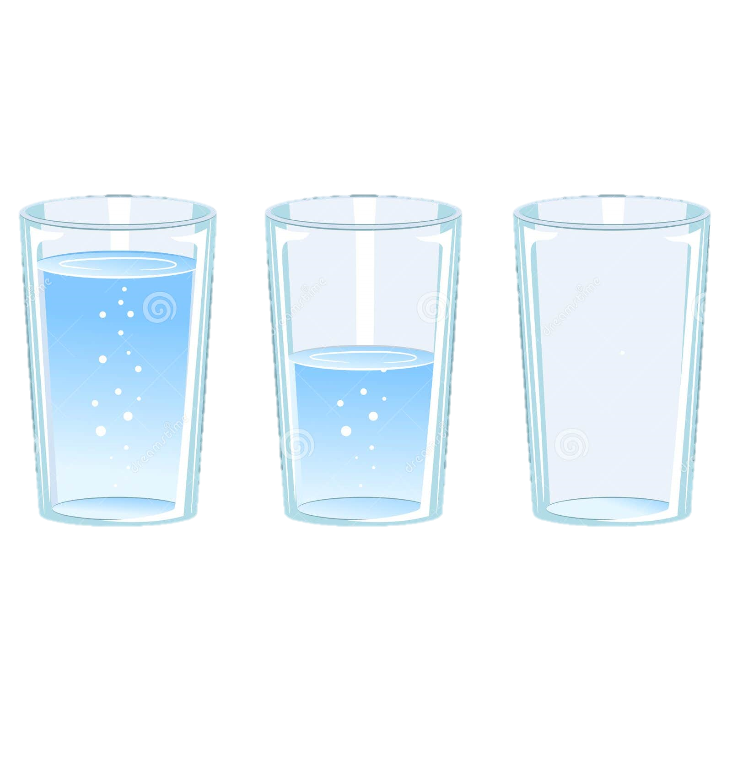
Conclusion
P-value is 0.0006986 which is lower that the significance level .05, therefore we reject the null hypothesis. There is sufficient evidence to conclude that mean water consumption is less than 64 ounces.
Mean water consumption is 44 ounces. / 64 ounces recommended
Average difference of 20 ounces.
*Each full glass represents 8 oz of water

Slide 7
Github
sjzimmermann/Data-211-Final-Project-2023 (github.com)

